Slide 1
Cross-Subsidization in Conglomerate Firms: Evidence from Government Spending Shocks
Darren J. Kisgen Boston College Carroll School of Management
Lei Kong University of Alabama Culverhouse College of Business
Presented by Austin Francis

Slide 2
Research Question
How do conglomerate firms (which operate in multiple industries) respond to demand shocks caused by changes in federal government spending?
Notes:
particularly if there is cross-subsidization (i.e., sharing of resources) between different segments of the firm.

Slide 3
Prior Literature
Conglomerates often trade at a discount relative to stand-alone firms, a phenomenon known as the "diversification discount" (Lang and Stulz, 1994; Berger and Ofek, 1995)​
Some studies argue that the value reduction of conglomerates may be due to internal choices, like a firm’s decision to diversify, which could reduce firm value (Campa and Kedia, 2002)​
Recent evidence suggests that corporate diversification does not always destroy value, as Boguth, Duchin, and Simutin (2022) found that conglomerates' divisions can operate effectively using new empirical methods

Slide 4
Hypothesis
The authors hypothesize that in conglomerates, segments more dependent on government spending will invest less when compared to similar stand-alone firms.
They also believe that segments less dependent on government spending will invest more when other parts of the conglomerate get a boost in government spending, indicating cross-subsidization.

Slide 5
Key Metrics
OWN_GD: Government dependency of each segment.
OTHER_GD: Government dependency of other segments in the same conglomerate.
Investment Rate: Capital expenditures divided by assets for each segment.
Government Spending: Measured using the amount of nondefense discretionary government spending.

Slide 6
Results
Segments that rely more on government spending invest less when they are part of a conglomerate compared to stand-alone firms.
When other segments of the conglomerate experience positive demand shocks from government spending, less government-dependent segments invest more, indicating cross-subsidization.
Cross-subsidization leads to worse performance for some segments and a larger diversification discount, meaning conglomerates may be less efficient overall.

Slide 7
Data Collection
Compustat Historical Segments data from 1977 to 2016

Slide 8
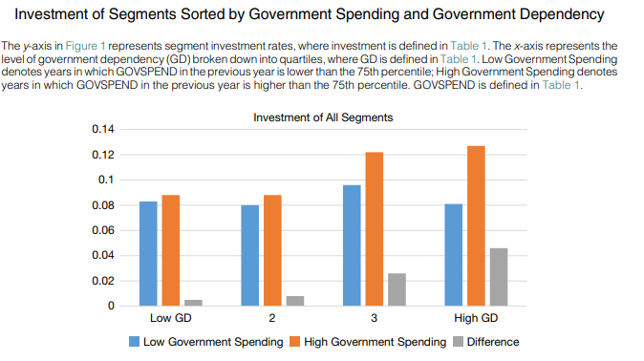
Notes:
To do so, we sort segment years along two dimensions: the government dependency of the segment and the level of government spending in the year. Specifically, we break down government spending into two groups: years in which government spending is higher than the 75th percentile and years in which government spending is lower than the 75th percentile. For each group, we calculate the average investment rate of segments in each government dependency quartile.

Slide 9
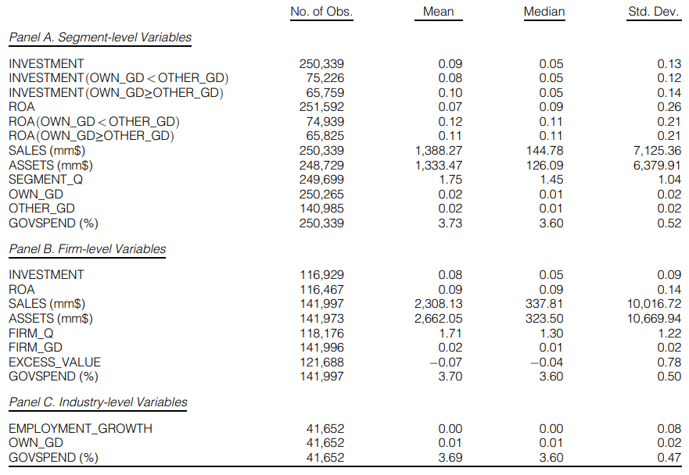
Table 1 – Summary Statistics
Notes:
The median segment in our sample has sales of $145 million, assets of $126 million, and a Q ratio of 1.45. It invests 5% of its assets each year and generates profits equivalent to 9% of its assets. In addition, 1% of its products are consumed by the federal government for nondefense purposes.

Slide 10

Model

Slide 11
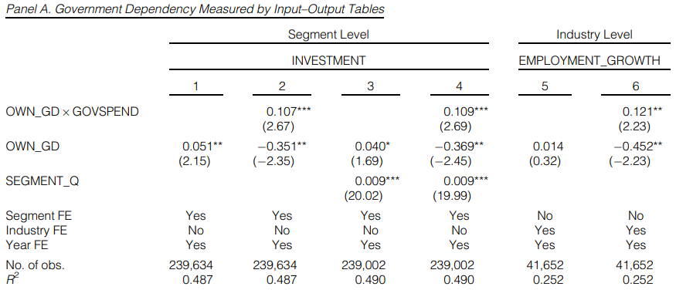
Table 2 – Government Spending Shocks and Segment Investment
Notes:
Segments more dependent on government spending increase their investment significantly during years of higher government spending.
Firms less dependent on government spending do not exhibit the same level of responsiveness, emphasizing the impact of government demand shocks.
The results hold both for public firms and in broader industry-level analysis that includes private firms.

Slide 12
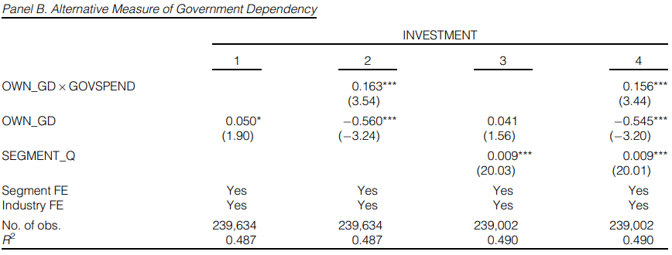
Table 2 – Government Spending Shocks and Segment Investment

Slide 13
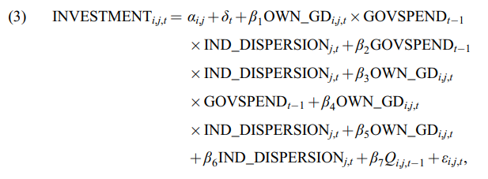
Model

Slide 14
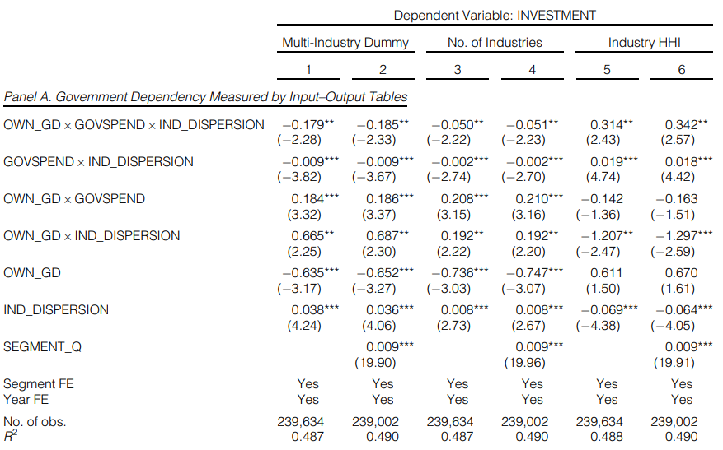
Table 3 – Industry Dispersion and Segment Investment Sensitivity to Government Spending Shocks
Notes:
Segments in multi-industry firms are less responsive to government spending shocks compared to single-industry firms.
Diversification across industries dampens the investment response to government demand shocks.
Higher industry dispersion tends to reduce the effectiveness of government-induced demand as a driver of investment growth.
Specifically, the estimates in column 1 indicate that for a 1-standard-deviation increase in government spending, segments in single-industry firms invest 0.92% (0.184 0.5 10%) more of their assets when they sell 10% more of their products to the government.12 However, for the same increase in government spending, similar segments in multi-industry firms only increase their investment by 0.02% of their assets (0.184 0.5 10%-0.179- 0.5 10%).

Slide 15
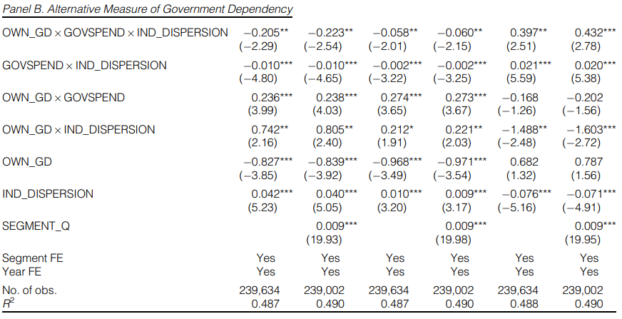
Table 3 – Industry Dispersion and Segment Investment Sensitivity to Government Spending Shocks
Notes:
In Panel B, we use only OWN_GD for segments in firms that are government suppliers and 0 for segments in other firms (i.e., our alternative measure). The results mirror those presented in Panel A.

Slide 16
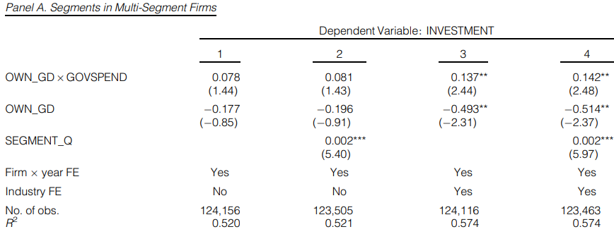
Table 4 – Segment Investment Sensitivity to Government Spending Shocks Within Multi-Segment Firms
Notes:
In Panel A, segments with higher government dependency increase their investment by 0.14% for every unit increase in government spending (significant at the 5% level).
In Panel B, compared to single-segment firms, multi-segment firms with higher government dependency reduce their investment by 0.12%. Segments within multi-segment firms invest more when government spending rises, but the response is weaker compared to stand-alone firms.
Cross-subsidization reduces the sensitivity of segment investments to government demand shocks.
Firms with multiple segments tend to distribute resources unevenly across segments during government spending changes.

Slide 17
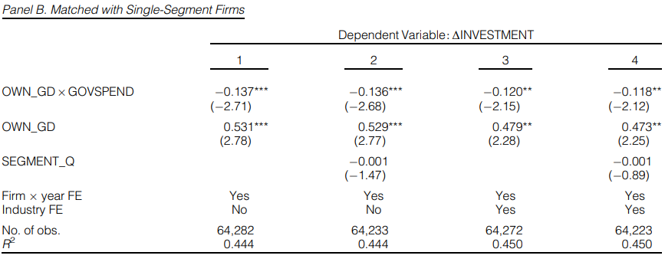
Table 4 – Segment Investment Sensitivity to Government Spending Shocks Within Multi-Segment Firms
Notes:
In Panel A, segments with higher government dependency increase their investment by 0.14% for every unit increase in government spending (significant at the 5% level).
In Panel B, compared to single-segment firms, multi-segment firms with higher government dependency reduce their investment by 0.12%. Segments within multi-segment firms invest more when government spending rises, but the response is weaker compared to stand-alone firms.
Cross-subsidization reduces the sensitivity of segment investments to government demand shocks.
Firms with multiple segments tend to distribute resources unevenly across segments during government spending changes.

Slide 18
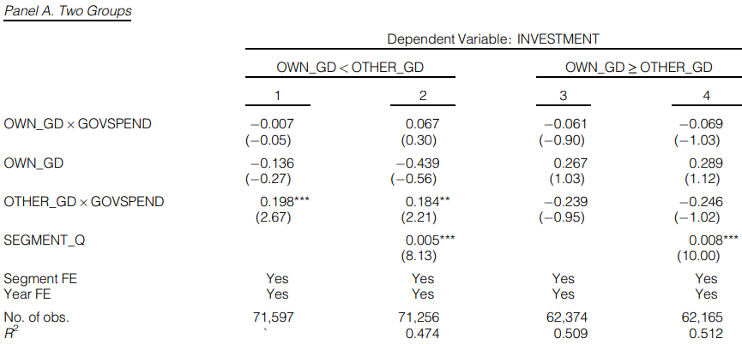
Table 5 – Government Spending Shocks and Cross-Subsidization
Notes:
Segments with lower government dependency increase their investment by 0.19% when government spending rises, while more government-dependent segments show no significant investment response. Segments that rely less on government spending invest more when other segments in the firm benefit from increased government funding.
Cross-subsidization appears stronger in firms with segments that vary in their government dependency.
The investment response to government shocks is asymmetric, depending on the firm's structure.

Slide 19
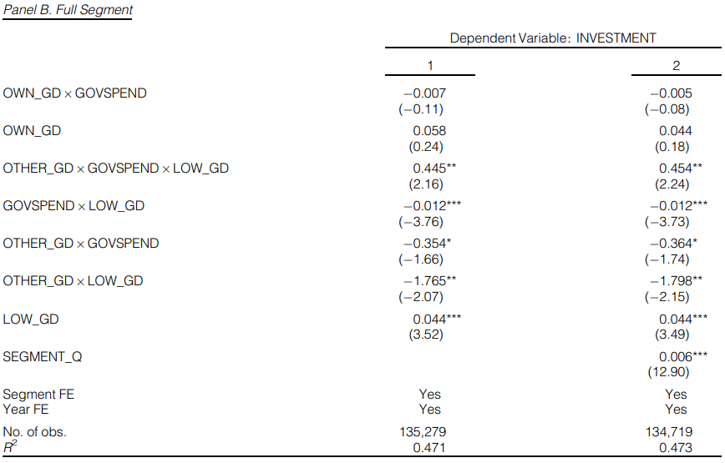
Table 5 – Government Spending Shocks and Cross-Subsidization
Notes:
Segments within firms with high government dependency in other segments reduce their investment by up to 0.35% when government spending increases.

Slide 20
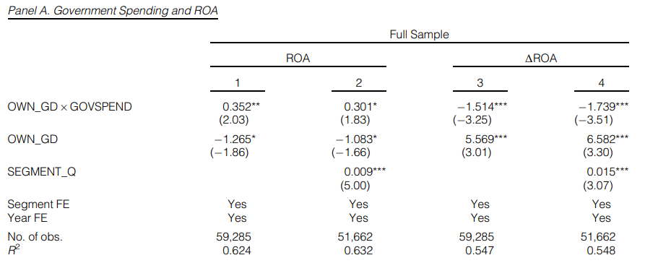
Table 6 – Cross-Subsidization and Operating Performance
Notes:
Segments with high government dependency experience a 1.5% increase in return on assets (ROA) for every standard deviation increase in government spending.
However, this increase is lower for conglomerate segments compared to stand-alone firms, which see an even higher increase in profitability. Cross-subsidization hampers the profitability gains of conglomerate segments when government spending rises.
Stand-alone firms benefit more from government spending shocks than conglomerate segments.
The negative impact of cross-subsidization on performance is notable, reducing the profitability advantage of multi-segment firms.

Slide 21
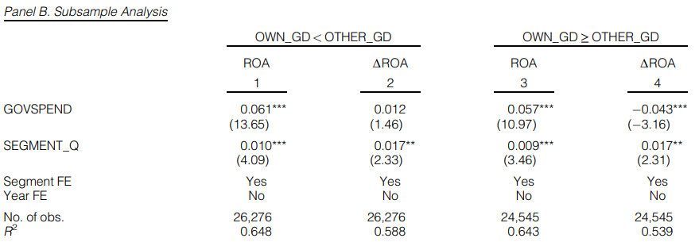
Table 6 – Cross-Subsidization and Operating Performance

Slide 22
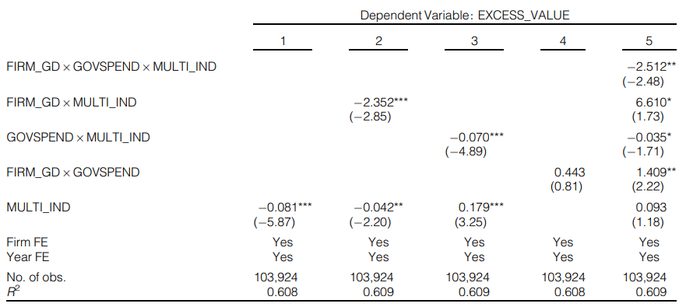
Table 7 – Cross-Subsidization and Excess Value
Notes:
KEY NUMBERS: Multi-industry firms trade at an 8.1% discount compared to single-industry firms.
This discount grows to 8.7% when government spending increases (column 3).
Firms with higher government dependency show a 2.35% additional discount (column 2).
KEY TAKEAWAYS: Multi-industry firms generally face a diversification discount.
Higher government dependency makes this discount worse.
Government spending shocks lead to an even greater discount in multi-industry firms.

Slide 23
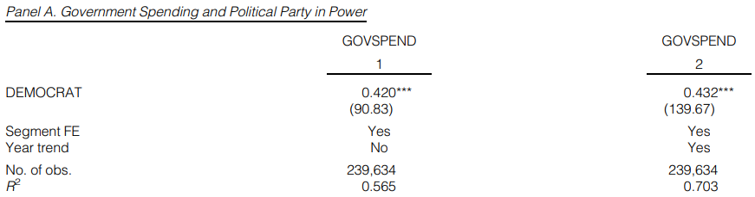
Table 8 – IV Analysis
Notes:
Overview of Results:
When Democrats control the government, government spending increases by 0.42%.
In multi-industry firms, government dependency combined with increased government spending leads to significant cross-subsidization effects (β = 0.347 for multi-industry firms, significant at 1%).
Key Takeaways:
Government spending tends to increase under Democratic control.
Firms operating in multiple industries see stronger cross-subsidization effects when government spending rises.
The instrumental variable confirms that political factors significantly influence the relationship between government spending and firm behavior.

Slide 24
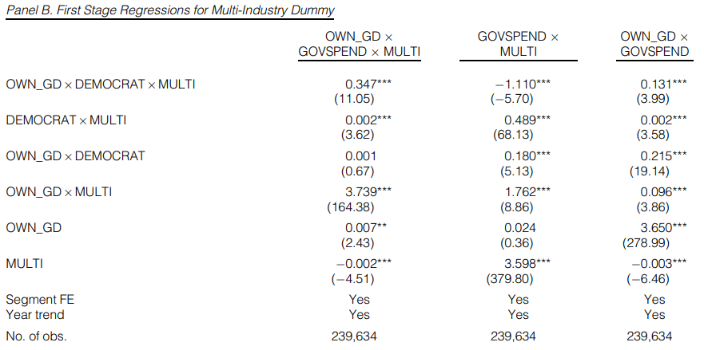
Table 8 – IV Analysis

Slide 25
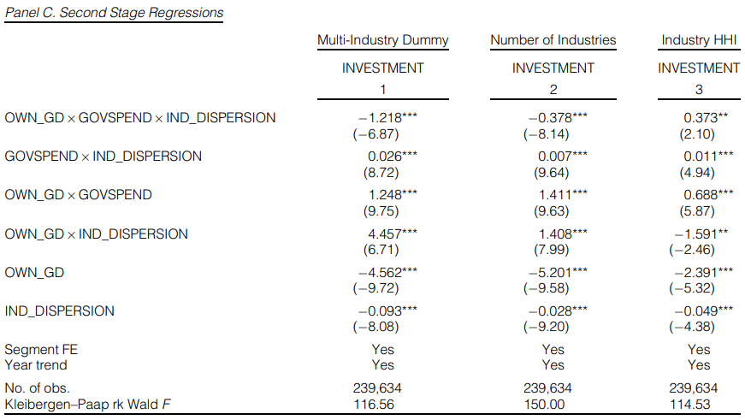
Table 8 – IV Analysis

Slide 26
Conclusion
Key Finding: Cross-subsidization occurs when some segments of a conglomerate benefit from demand shocks (like government spending) while others contribute resources, leading to less efficient overall performance.
Investment Sensitivity: Segments with higher government dependency in multi-segment firms invest less in response to demand shocks than stand-alone firms.
Profitability Impact: Cross-subsidization harms operating performance, as conglomerate segments that share resources with other segments see smaller profitability gains.

Slide 27
Conclusion
Valuation Consequences: The diversification discount in conglomerates is worsened by cross-subsidization, especially during periods of higher government spending.
Policy Implication: The paper suggests that while diversification can buffer against shocks, internal capital reallocation (cross-subsidization) often reduces efficiency and firm value.

